Slide 1
IEEE
ARDUINO
Workshop

Slide 2
Annoucements

Slide 3
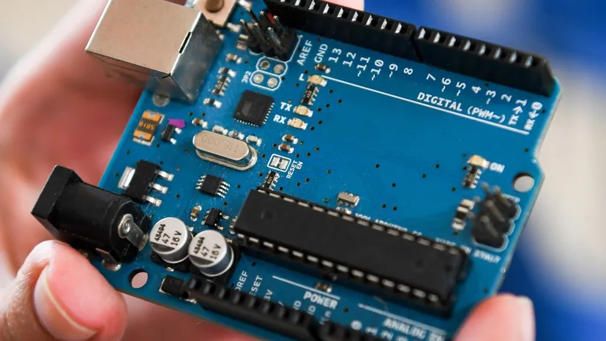
What is a microcontroller?
At its core, a microcontroller is a programmable circuit that runs something physical (usually voltage on/off) to control something else. Something like a Raspberry Pi is NOT a microcontroller - it has its own operating system & can do more, but reacts slower because of it.
You should use a microcontroller when you need to sense your surroundings and respond to them automatically & reliably. Use a more complicated device like a Pi when your project needs lots of storage or processing, and the preciseness of responses doesn’t matter as much.

Slide 4
What you need for this activity
Arduino IDE 2
USB cable to flash code
Code to be flashed
github.com/iancinder/ArduinoWorkshop
Go to FirstActivity, then download FirstActivity.ino

Slide 5
Plan
Part 1
Part 2
Part 3
Test your own reaction speed by tapping a jumper the moment an LED lights up
Test the microcontroller’s reaction speed by tapping a jumper the moment an LED lights up
How to Claude!!!
Installing Claude into Arduino IDE & how to get the most out of AI
Why it matters: Anything that must react instantly and the same way every time (eg airbags, pacemakers) runs on a microcontroller.

Slide 6
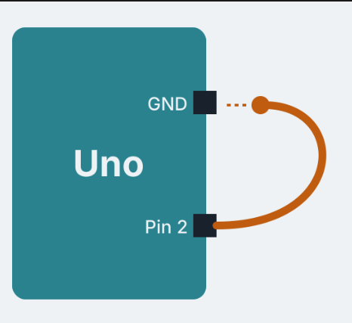
Arduino Activity
PART ONE
  Upload FirstActivity.ino to your Uno
    Plug in cable to laptop, flash through the Arduino IDE w/ the little arrow in the top left
  Open the Serial Monitor
    Tools → serial monitor
  Plug a male-male cable into pin 2 - the other end will be what you complete the circuit and “react” with
  When the L LED lights, tap your key into GND. You get 5 tries

Slide 7
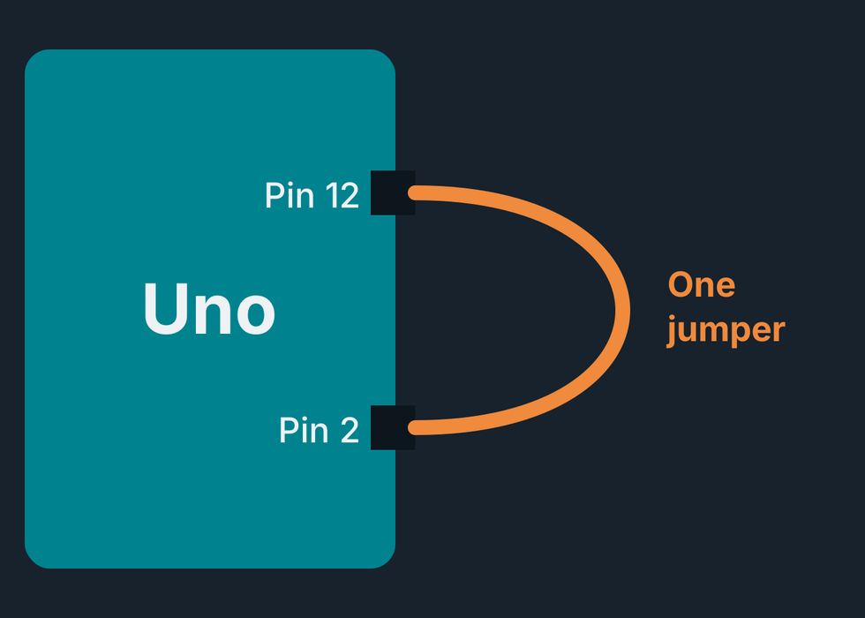
Arduino Activity
PART TWO
  Take your key’s free end off the rail.
  Plug it into pin 12, so pin 2 is wired to pin 12.
  The Uno spots the new wiring and races itself 5 times.
How many times faster than you do you think the UNO will be?

Slide 8
Arduino Activity
PART THREE
Medium
Average
You
____ ms
  Join the WiFi network ReactionTest-1.
  The test opens by itself. If not, go to 192.168.4.1 (type into url on laptop)
  Tap to start, wait for green, then tap as fast as you can
The UNO
____ us
Your Phone
____ ms

Slide 9
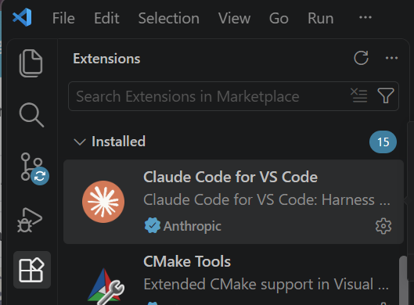
How to install Claude in an IDE
An IDE is an app that combines a code editor, tools to run your code, and a debugger in one place. VS Code is the free default for most beginners
To add Claude to VS Code, search “Claude Code” in the Extensions view, install Anthropic’s extension, and sign in with your UT EID email.
This makes the workflow much smoother: Claude works directly on your files instead of you copying and pasting changes, and it sees your whole project, not just the slice you’re working on

Slide 10
Workflow w/ AI
Prompt
Implement
Test
Figure out what it is you want before you start making. Ensure you and Claude are on the same page before wasting time building the wrong thing - ask it to preview what it thinks you want, then go from there.
The fun part! I suggest going part by part rather than trying to “one shot” your whole project, as iterative testing is much easier to get a closer reflection of what you were actually envisioning
Test what you built, then if changes are needed go back to the prompting stage!
Why it matters: With AI as good as it is, it’s important to understand how to use it to get the maximum productivity possible out of yourself.

Slide 11
Keep going with an Uno and a few jumpers
One UNO
Morse code messenger
Conductivity tester
Ghost detector
Type a message in the Serial Monitor and the L LED blinks it in morse code
Jumpers in A0 and GND are probes. Touch them to skin, a coin, whatever - the A0 reading shows what conducts.
Plug a male-male wire into A0 - Wave your hand near it and get it to update on Serial Plotter
Two UNOs
Telegraph
Reaction duel
Connect two Unos with jumpers (pin 7 to pin 8 each way, plus GND to GND). Tapping your key lights your partner’s LED, letting you send Morse back and forth.
One LED, two players, two keys - both of you try and react first, the board tells you who won.

